Slide 1
Group 5 Project: Movies
Kirby Judd, Purnima Pathak, David Jolia, Anthony Youssef

Slide 2
What makes a “successful” movie?

Slide 3
Success Metrics
Financial Success (Box Office Revenue $, Return on Investment (ROI), and Profitability)
Award Wins/Nominations (Oscars)
Movie Review Ratings (IMDb, Rotten Tomatoes, Metacritic)
Popularity

Slide 4





Getting the Data
Kaggle:
1287 movie data from TMDB(The Movie Database) from the year 1961 - 2015.
Columns include Movie ID, Budget, Revenue, Profit, Title, Cast, Directors, Popularity, Keywords, Runtime, Genres, Production Company, and Release Date
OMDB API:
Used Movie IDs in Kaggle Data to create requests.
Supplemented Kaggle Data with Awards, Ratings, Metascore, Imdb Rating, and Imdb Votes for each movie

Slide 5
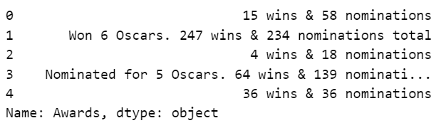
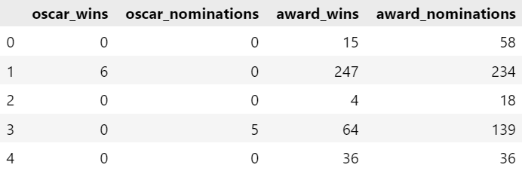
Cleaning the Data
STEP 1: Merge Kaggle and OMDB API data based on the movie ID
STEP 2: Convert string data to appropriate data types, eg. Box Office revenue to type integer and Release date to datetime.
STEP 3: Parse through awards column and get appropriate values for each
.
.
STEP 4: Export Data as CSV

Slide 6
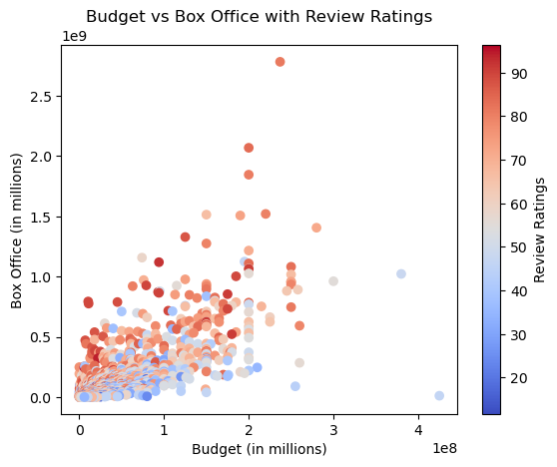

Slide 7
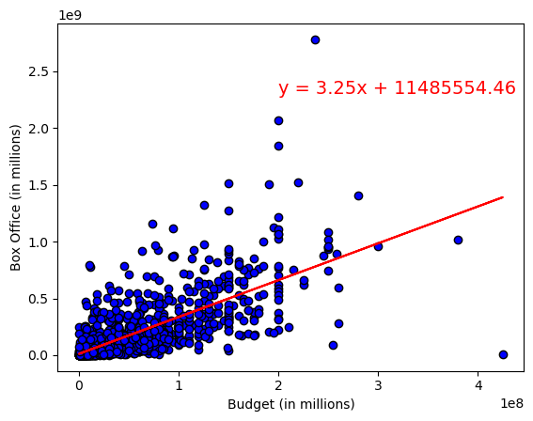
R-squared value = 0.49

Slide 8
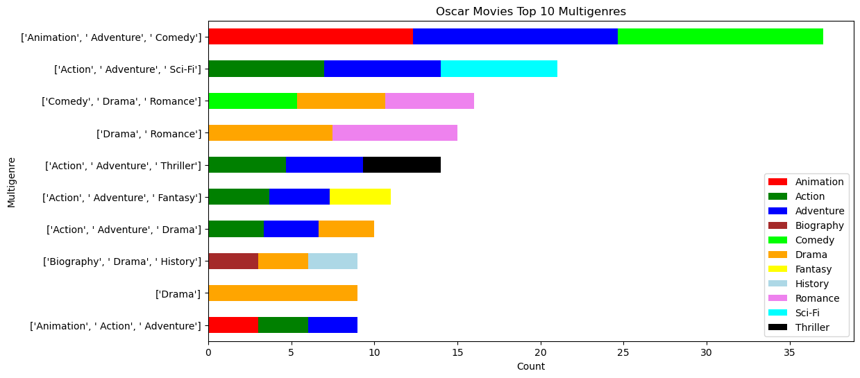
Kirby’s Graphs
Toy Story
Marvel Movies - “Iron Man”
Silver Linings Playbook
Titanic
James Bond - “Skyfall”
Avatar
The Lord of the Rings
Schindler's List
Fight Club
Beowulf

Slide 9
Kirby’s Graphs

Slide 10
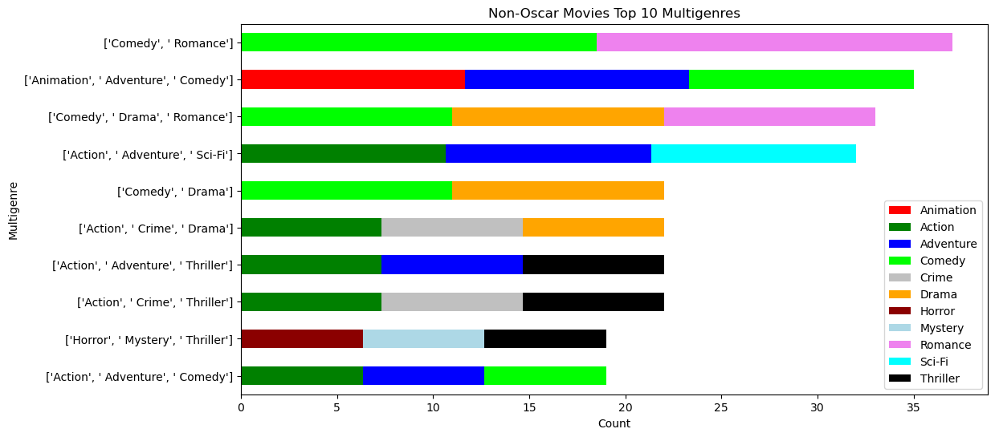
Kirby’s Graphs

Slide 11
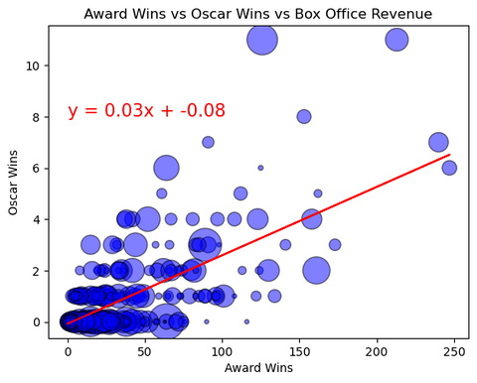
R = 0.742614

Slide 12

Movie Keywords Example

Slide 13
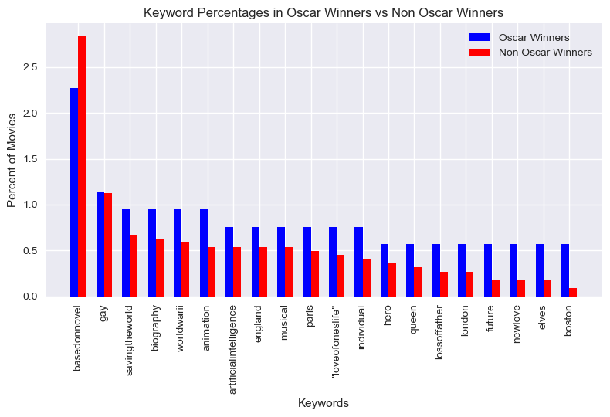

Slide 14
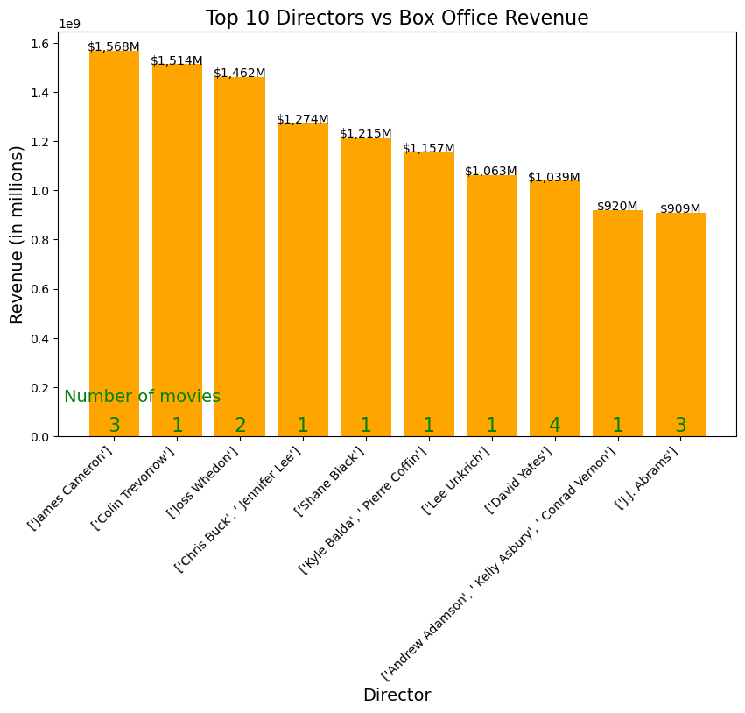

Slide 15
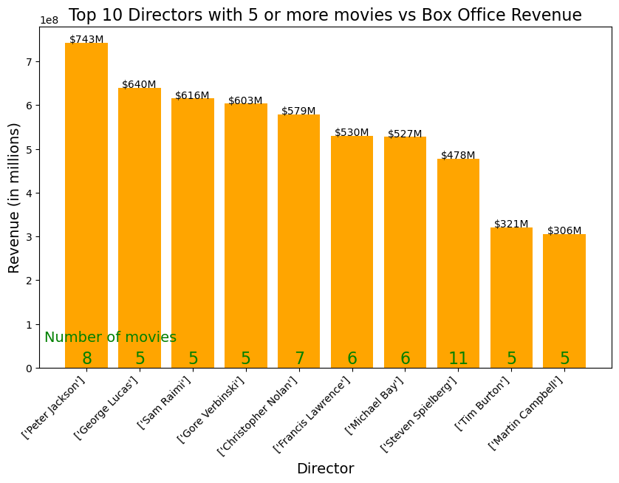

Slide 16
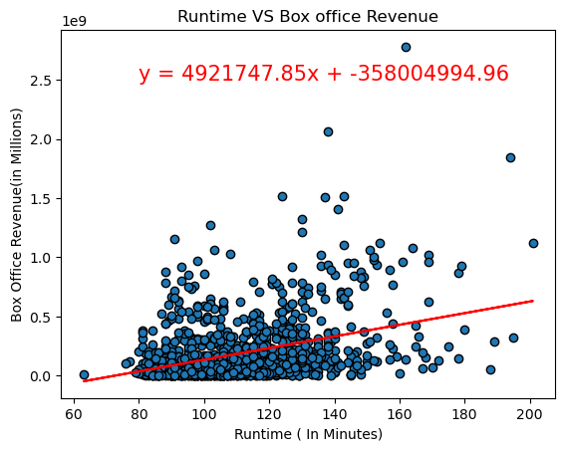
R-squared value = .13

Slide 17
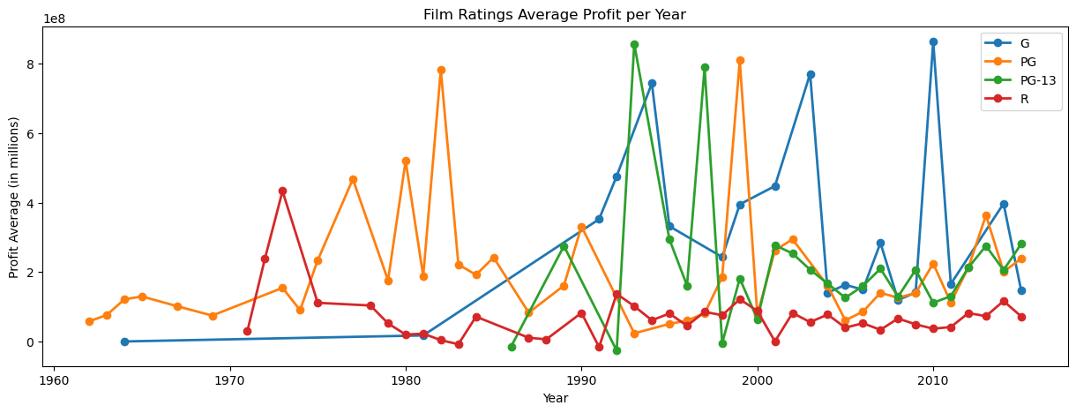
Kirby’s Graphs

Slide 18
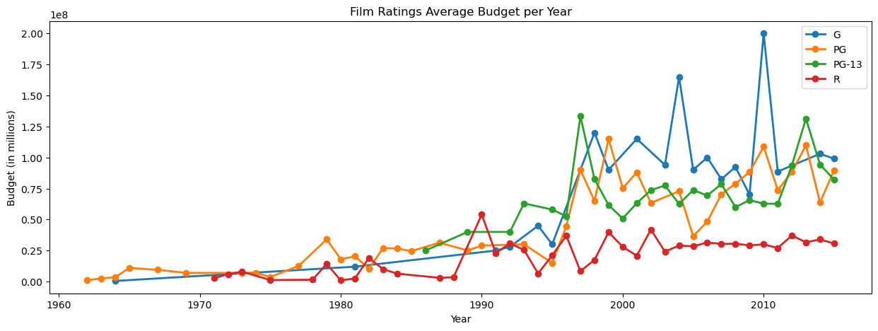
Kirby’s Graphs

Slide 19
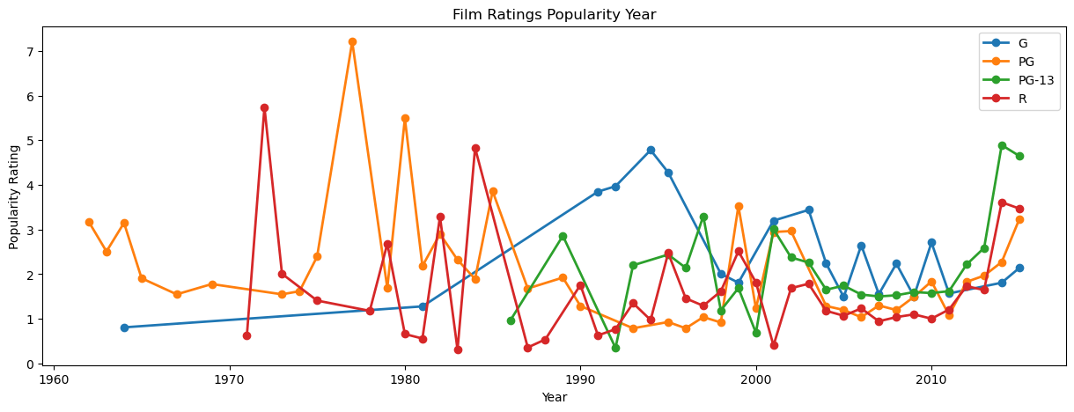
Kirby’s Graphs

Slide 20
Discussion and Limitations
Use more than 1178 rows of data to get better representation
G-Rated movies were significantly lower than R-Rated movies in dataset
Data runs from 1961 to 2015, could use more up to date data (2023)

Slide 21
Conclusion
Box office revenue, ROI, and profitability
Oscar award wins and nominations
Movie Review Ratings (IMDb, Rotten Tomatoes, and Metacritic
Popularity

